Slide 1
TDR
Moving structure

Slide 2
1 - Input
We want our robot to be able to move on the table and follow a predetermined path. It therefore needs to be able to :
go forward
make a turn
measure its moves

Slide 3
1 - Input
Constraints
The dimensions of the robot are limited by the rules.
To prevent any failure of the camera technology, the robot must be able to compete even without it, it then needs to:
be precise enough in its measures to be able to move on its own
avoid obstacles (see TDR proximity sensors)

Slide 4
2 - Analysis : General form
A robot that can make a 360° turn without changing position is easier to manipulate for it does not needs to maneuver.
A structure in circle cannot impact any obstacles when turning
A square structure allows a more simple and efficient placement of the components but can hit some obstacles while turning (still needs a full circle during a rotation)
All moves can be decomposed in a rotation and a go straight

Slide 5
2 - Analysis : Way of moving
Many different ways of moving exist
wheels (classic, mecanum, directive or not)
tracks
feet
The terrain is smooth and regular, so no big advantage for tracks
Feet are difficult and space-greedy
A smart placing of non-directive wheels can permit all wished movements

Slide 6
2 - Analysis : Reading movement
To know its position without exterior input, the robot needs to be able to quantify its own movement
Rotary encoders are an easy and robust way to do so, two kinds exist :
Incrementals, they do not record the position after a power loss
Absolutes
→ No need for absolute encoding, we only want to evaluate a relative movement
Where to put the encoders?
Directly on the motor tree : risk of play in the motor/reducer/wheel chain
On the motor wheel : the motor wheel needs to be large, whereas a precise measurement wants a punctual contact
On free independent wheels : structurally tougher but allows both the motricity and the reading to be optimised independently

Slide 7
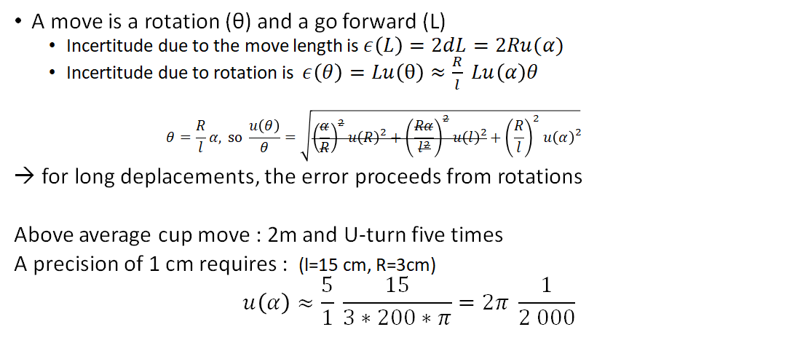
2 - Analysis : Reading movement
Tres bien !
The rotary encoder needs to have a precision of at least 1/2000 of turn

Slide 8
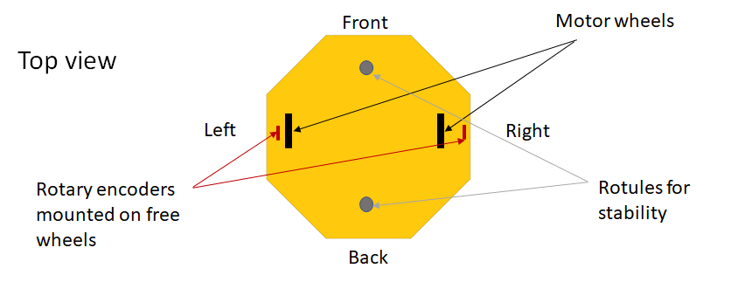
3 - Choice of structure
Notes:
Attention : 4 roues => hyperstatique : comment garantissez vous d’avoir toujours les 2 roues motrices en contact ?

Slide 9
3 - Choice of structure
An octagon is a compromise between a circle and a square
This form of structure has made its proof with our predecessors
Separating the encoding from the motricity
the encoders would be mounted on independent free wheels that could be narrower than the motor one
the encoding wheels would need to be equipped with shock absorbers to ensure that they are always in contact with the floor
the only movement allowed for the wheel needs to be vertical to maximize precision
→ Necessity of an efficient shock absorber paired with a good slide liaison

Slide 10
3 - Choice of structure : What encoders
MUJE 1000 p/r 4mm https://www.robotshop.com/en/rotary-encoder-1000p-r-3-channel-4mm-npn.html •Small (25,5x41mm) •Not that precise •Cheaper (48$) •Weight 0,1kg | Muje 5000p/r 6mm https://www.robotshop.com/en/rotary-encoder-5000-p-r-3-channel-6mm-npn.html •Bigger (38x55mm) •More precise than needed •More expensive (70$) •Weight 0,1kg
The Muje choice proceeds from their compactness and their precision
Our numeric analysis shows us that we need the 5000 p/r one

Slide 11
3 - Choice of structure
The final Robot needs to look clean and professional, to do so :
we choose the outer envelope to be in opaque plexiglas, for the robot to remain as mysterious and modern as possible
the frame too will be in thick plexiglas for prototyping reasons, in metal if possible

Slide 12
4 - Conclusion
The robot structure is an octagon, close of a circle for turning but still allowing an easy placing of components.
Separation of motricity and encoding, a bet to gain precision and efficiency
For the material, the most important thing is that it looks clean, opaque plexiglas can hide the electronics while providing a nice looking appearance

